Slide 1

Module 1
Regression Basics
Notes:
Guidelines
Use section headers to chunk content in your presentation.
Use the same style of section header throughout your presentation.
Keep your title to no more than 2 lines.

Slide 2
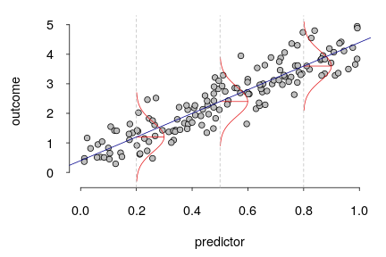
Assumptions, MSE, RMSE
Notes:
Guidelines
Use a title slide at the beginning of your presentation. There are 9 variations of title slides to choose from.
If you will have a series of slideshows, we recommend using the same style of title slide for each presentation.
Keep your title to no more than 2 lines.
Do not change the font style or font size of the title or subtitle.

Slide 3

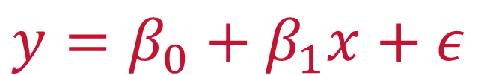
Linear Regression Assumptions
The mean of the probability distribution of $ε$ is 0.
The variance, $σ^{2}$ of the probability distribution of $ε$ is constant
The probability distribution of $ε$ is normal.
The errors associated are independent.
$$y=β_{0}+β_{1}x+ε$$

Slide 4
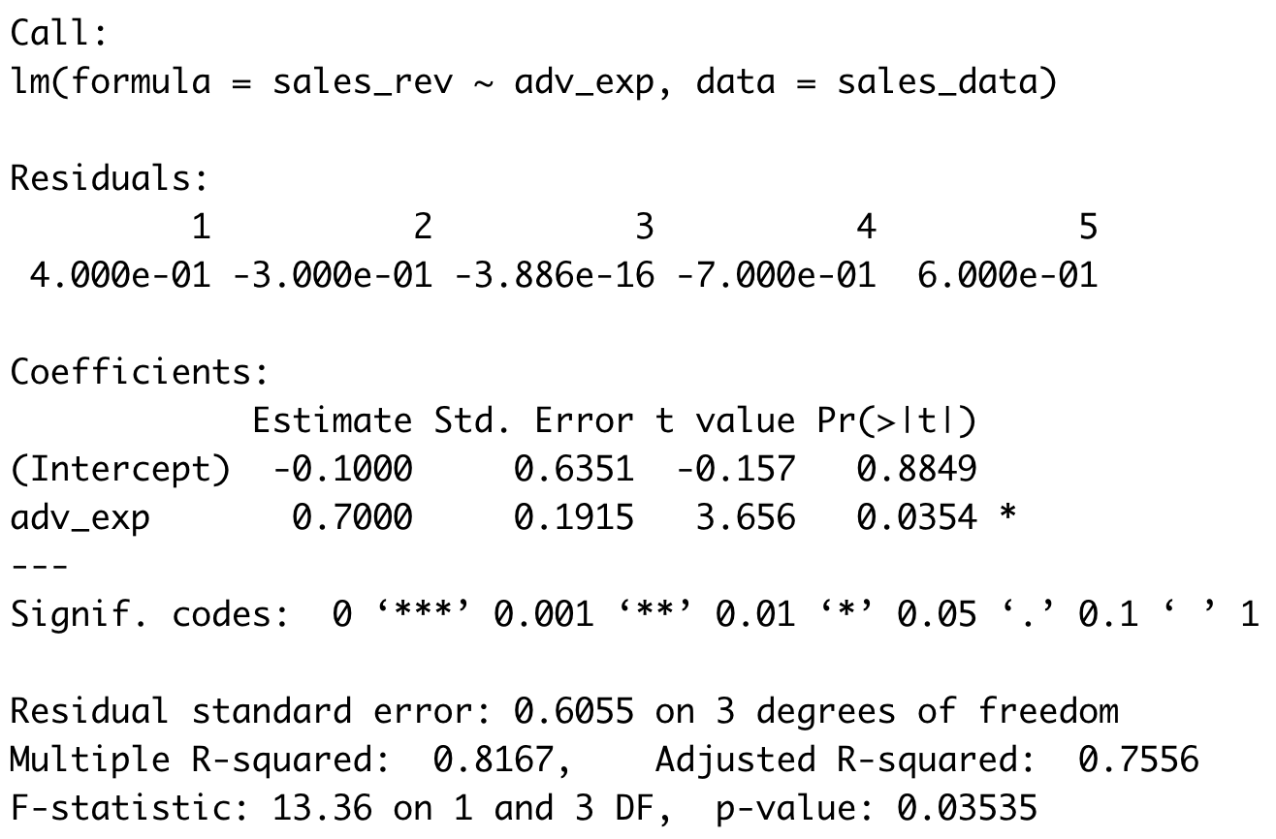

(Least-Squares) Estimates
Assumptions need to hold for p-values to make sense

Slide 5

Practice

Slide 6

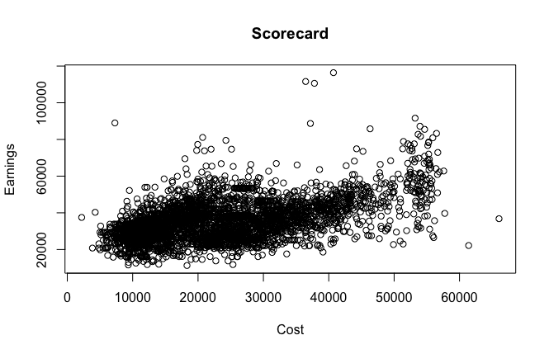
Example
y = md_earn_wne_p10
x = Cost4_A

Slide 7
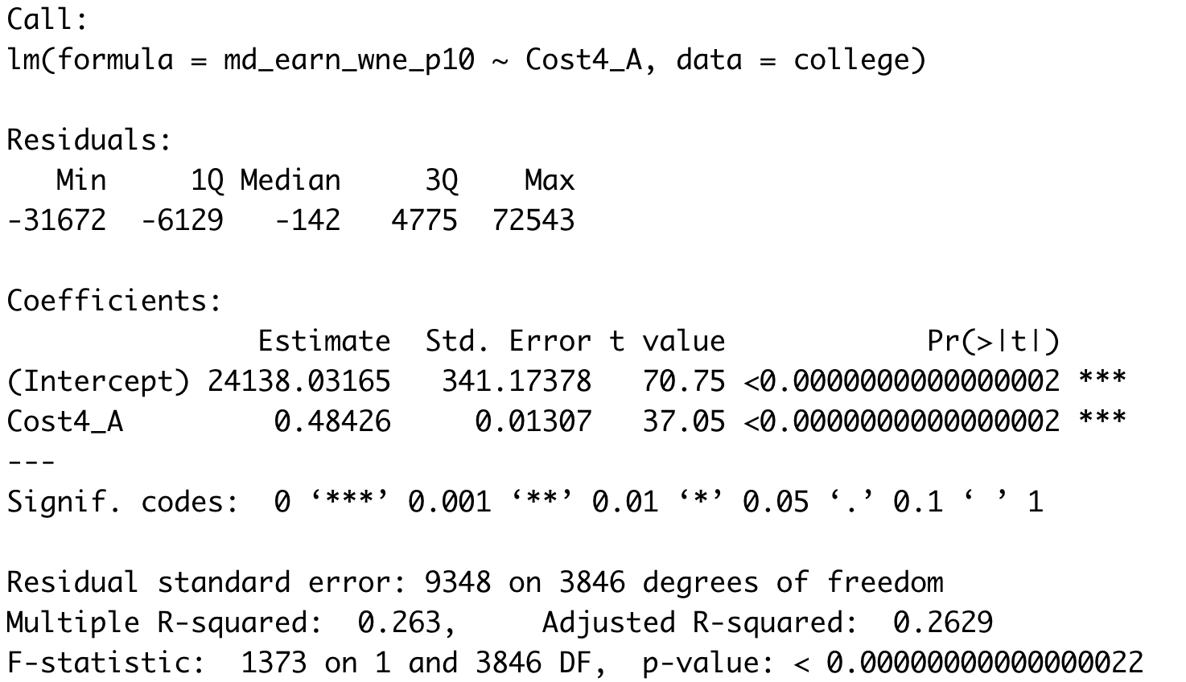

Least-Squares Estimates
Inference on ${\hat{β}}_{1}$ depends on the assumptions being valid
b0
b1

Slide 8
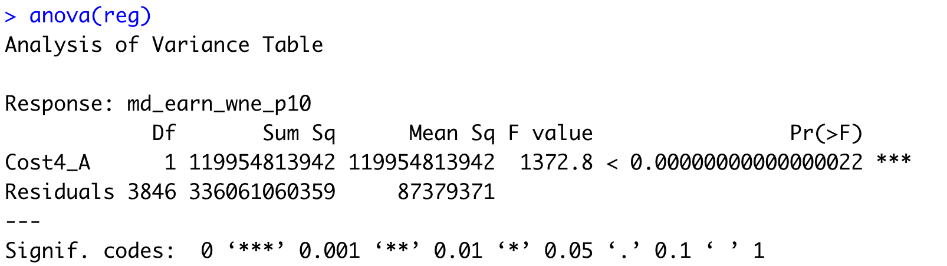

Sum of Squared Errors
Inference on the $F$ statistic depends on the assumptions being valid
Sum of Squared Errors (SSE)

Slide 9
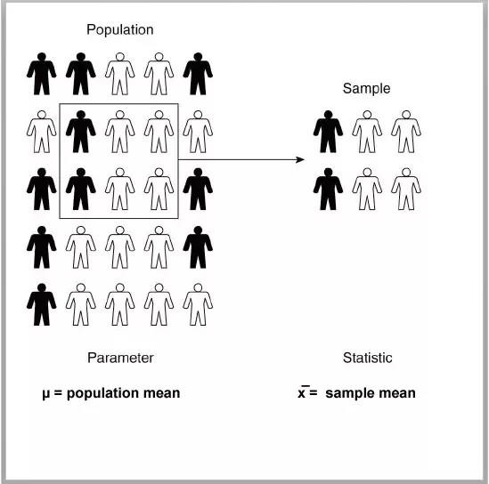



Assumption 1: MEAN OF $ε IS ZERO$
This means that the model is NOT biased
$$ε$$
$$e$$

Slide 10
Practice

Slide 11
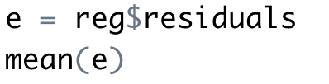
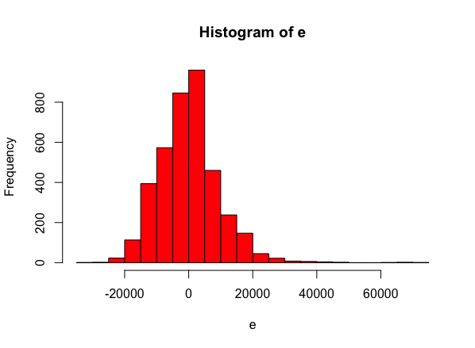
Assumption 1: MEAN OF $ε IS ZERO$
This means that the model is NOT biased

Slide 12
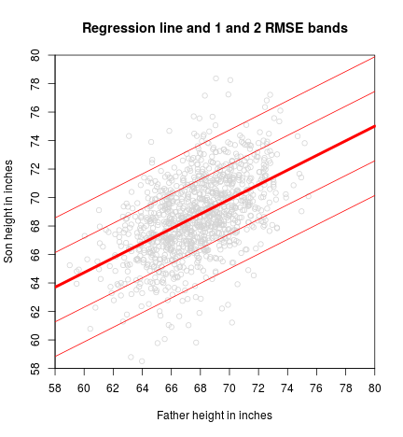



Assumption 2: VARIANCE OF $ε$ IS CONSTANT
The estimate of the variance is MSE
$$MSE= s^{2}=\frac{SSE}{n−2}$$
RMSE = $s=\sqrt{s^{2}}$
This is called the mean squared error (MSE). Measured in squared units
For a measure with the same units as the response use the root mean squared error (RMSE)

Slide 13
Practice

Slide 14
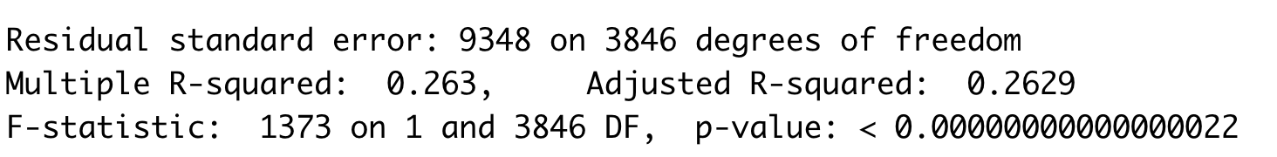
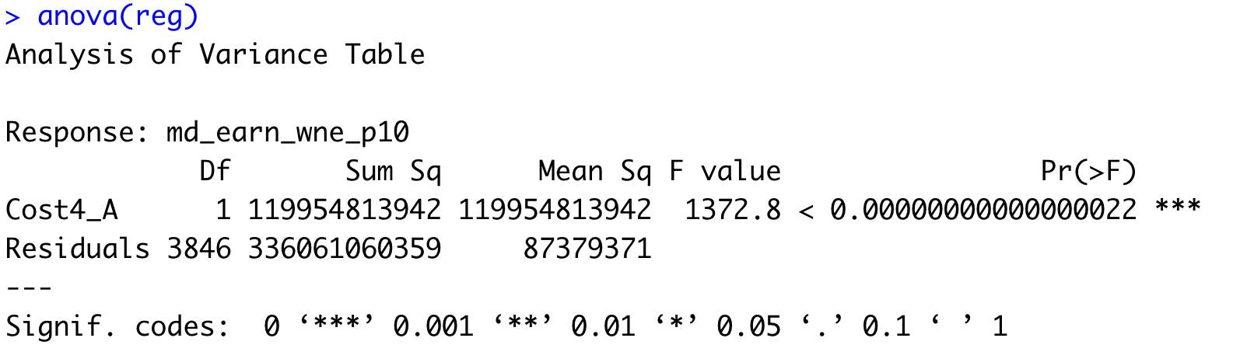


Assumption 2: VARIANCE OF $ε$ IS CONSTANT
RMSE and MSE are part of the regression output
$$RMSE$$
$$MSE$$

Slide 15
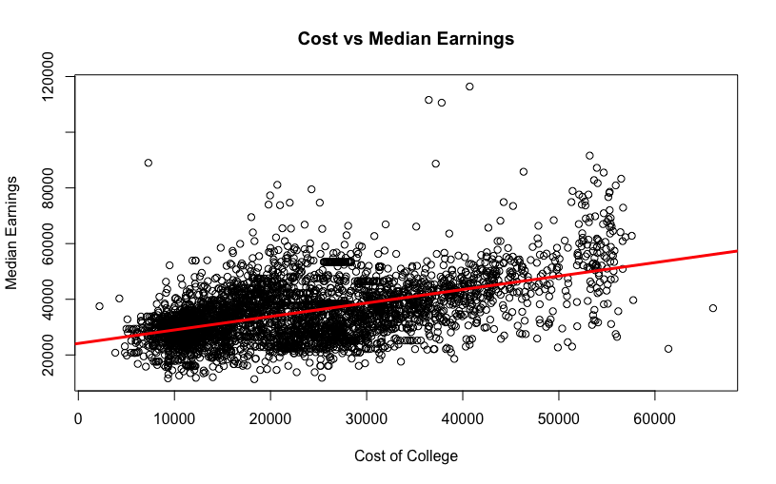
Assumption 2: VARIANCE OF $ε$ IS CONSTANT
You can check the scatter plots for constant variance

Slide 16
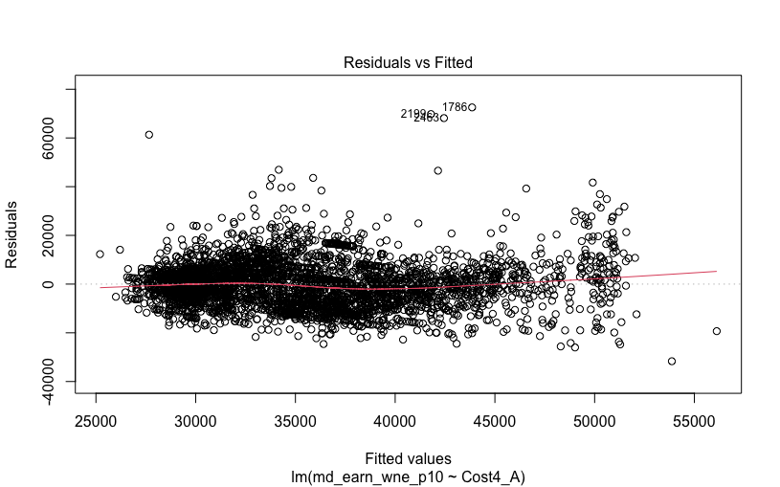
Assumption 2: VARIANCE OF $ε$ IS CONSTANT
For MLR, the residuals vs predicted is better using plot(reg)

Slide 17

Assumption 3: $ε$ IS NORMALLY DISTRIBUTED
You can check the residuals using histograms

Slide 18
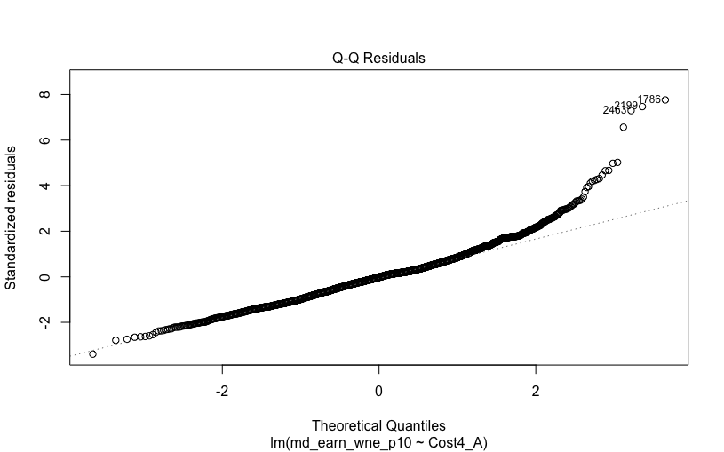
Assumption 3: $ε$ IS NORMALLY DISTRIBUTED
A Q-Q Plot is an easier plot to visualize

Slide 19
Practice

Slide 20
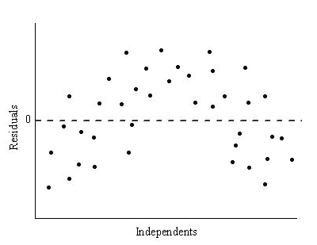

Assumption 4: $ε_{i}$ ARE INDEPENDENT
We are able to test this if we have a time/order variable
Time/Order Variable

